Slide 1
PRATIK MANE
YEAR – 2004
MODEL – DEEP LEARNING

Slide 2
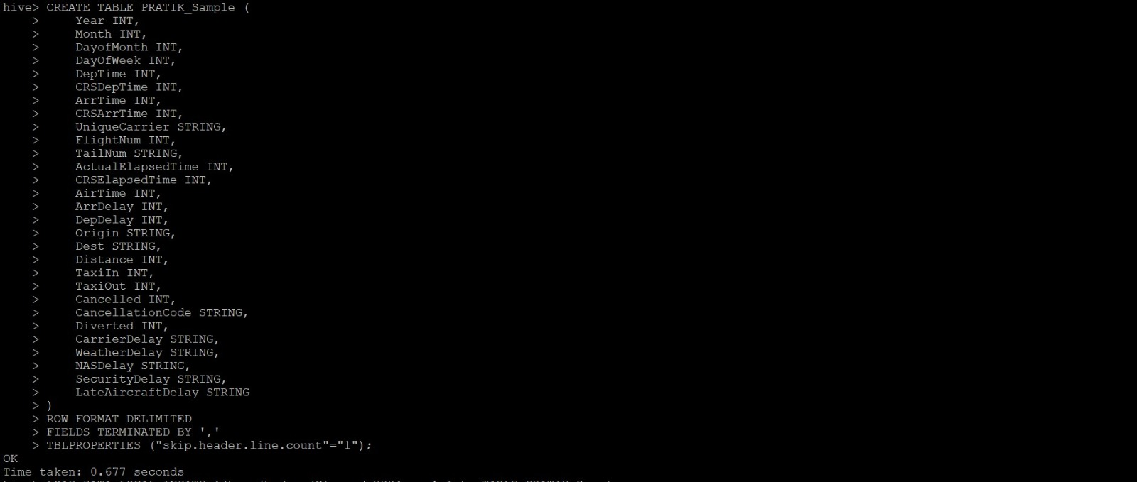
Create table In Hive using Hadoop Cluster in aws

Slide 3
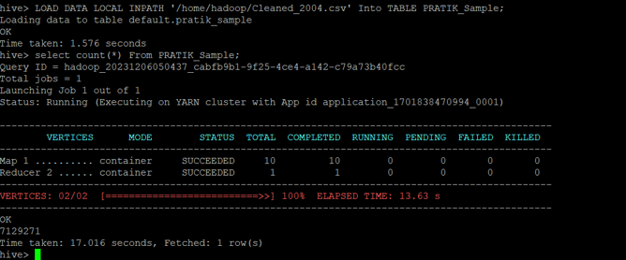
Uploading the Count and counting the size of data

Slide 4
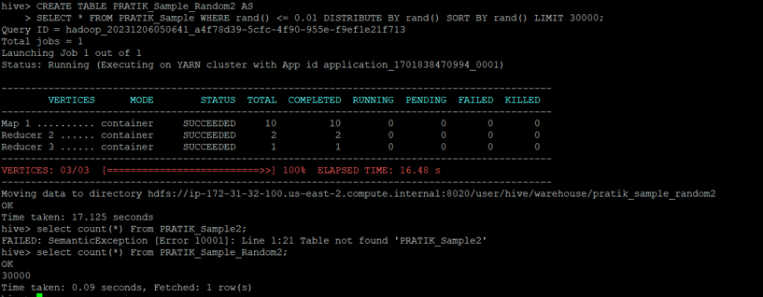
Randomizing AND FETCHING 30,000 RECORDS ALONG WITH COUNT TO DISPLAY 30,000 RECORDS

Slide 5
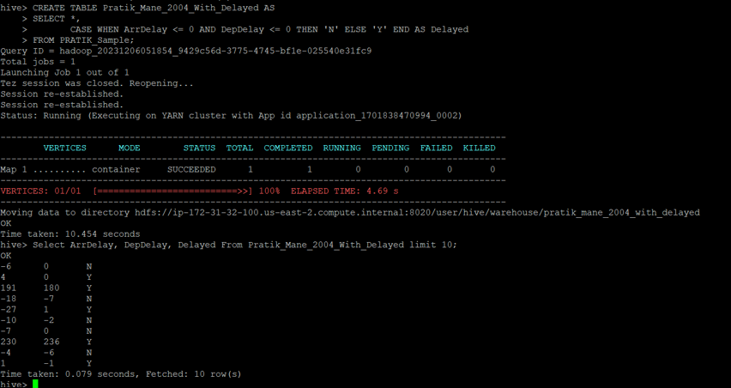
ADDING DELAYED COLUMN Verifying if the condition is applied properly

Slide 6
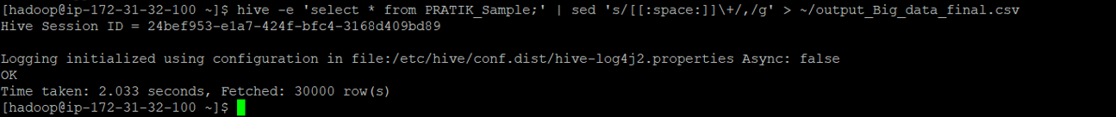
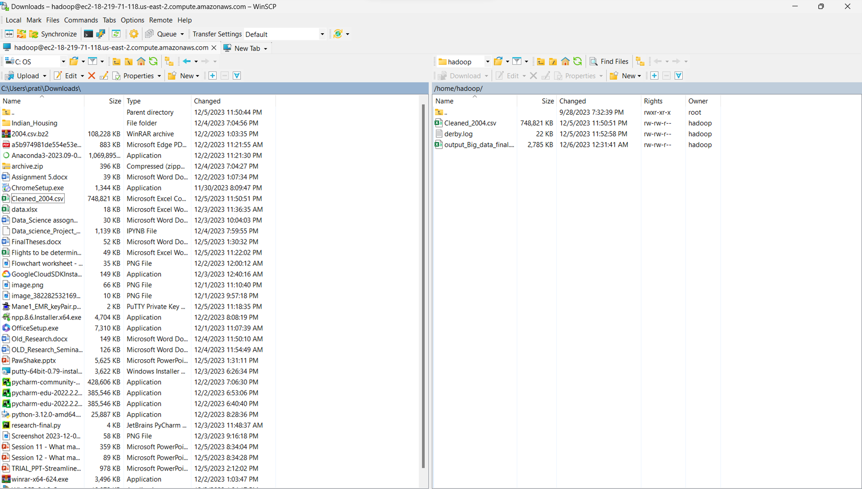
Export 30,000 in Winscp

Slide 7
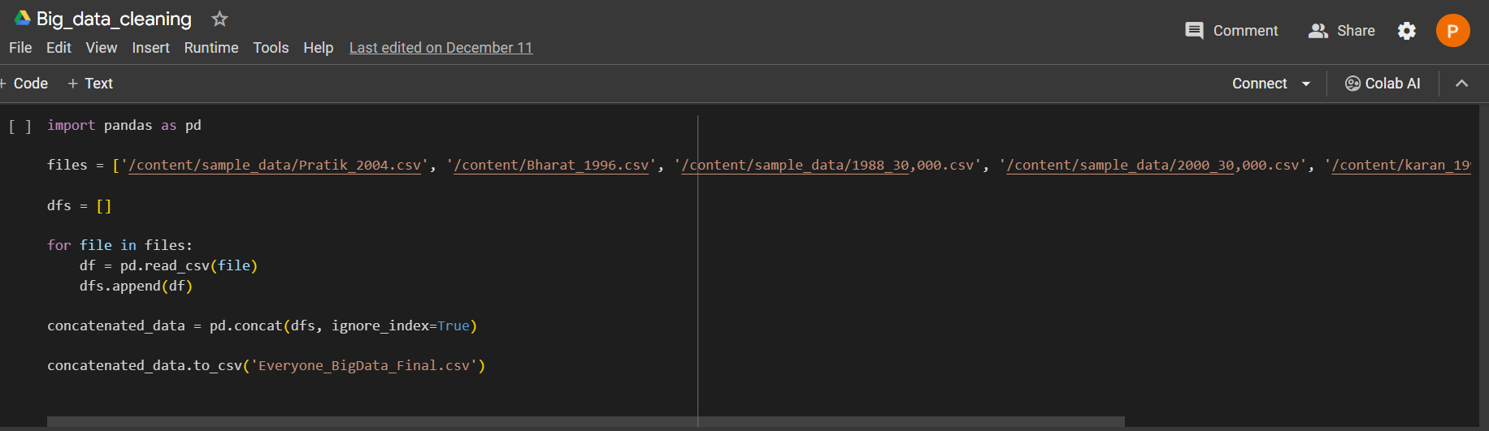
Merging data

Slide 8
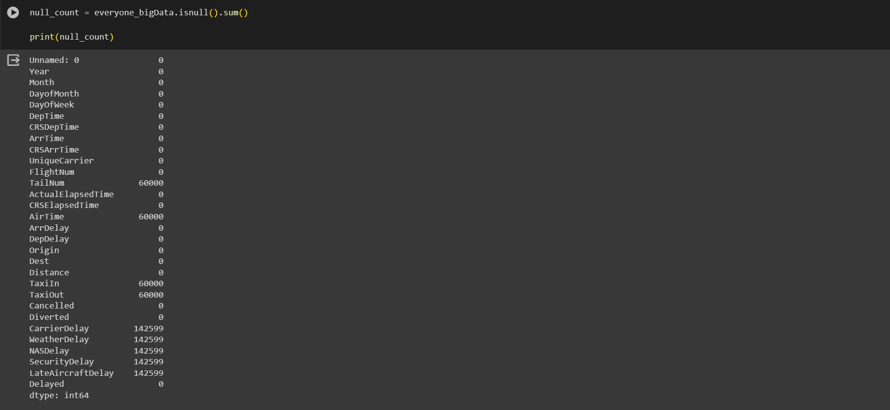
Finding null columns

Slide 9
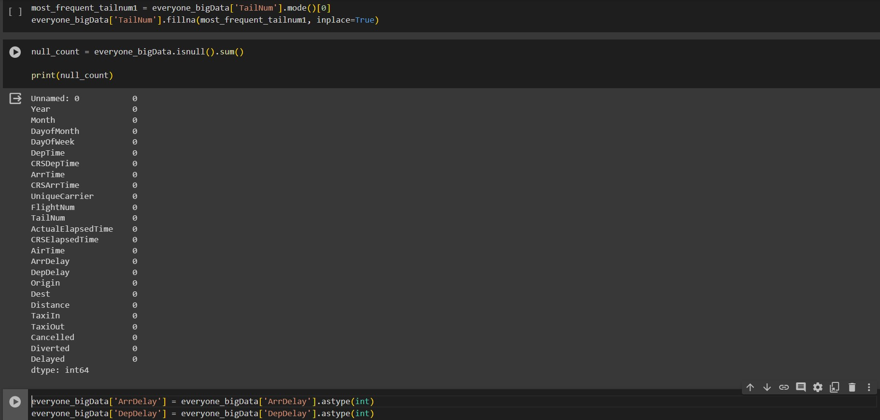
Remove unnecessary columns and replacing categorical variable with mode

Slide 10
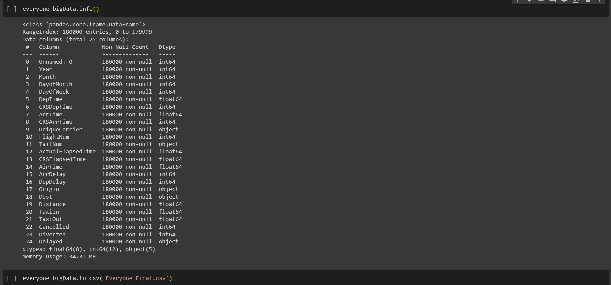
Info of the merged data

Slide 11
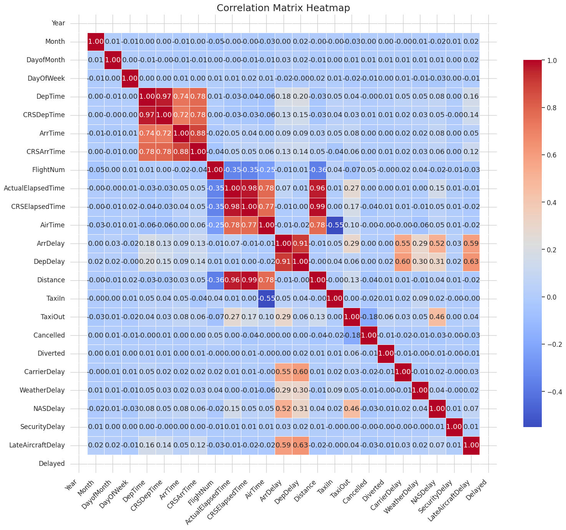
HEATMAP TO SEE THE CORRELATION

Slide 12
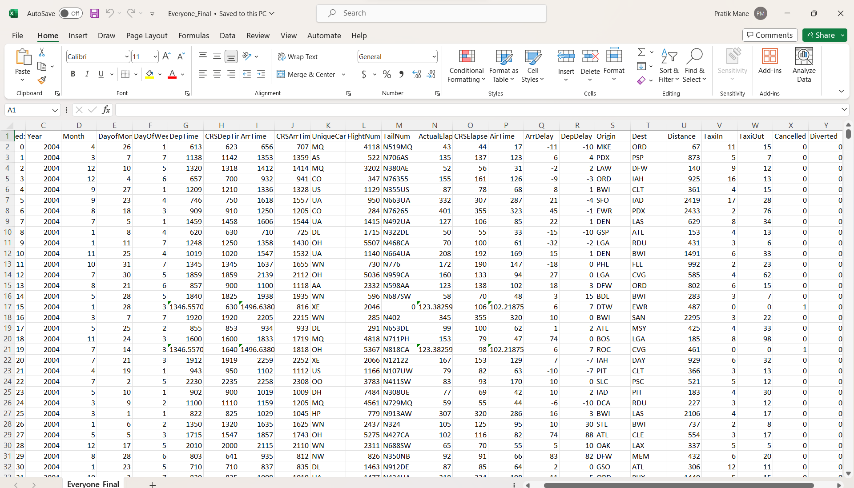
Merged Excel File

Slide 13
MODEL PROCESSING
DEEP LEARNING

Slide 14

Deep Learning Methodology
Data Retrieval: Load the dataset into the workflow.
Set Role: Designate roles to specific data columns, such as the target variable.
Select Attributes: Choose relevant features to include in the model.
Split Data: Divide the dataset into training and testing subsets.
Deep Learning: Construct and train the neural network model on the training data.
Apply Model: Use the model to predict outcomes on both training and testing sets.
Performance: Evaluate the model's predictions using appropriate metrics.

Slide 15
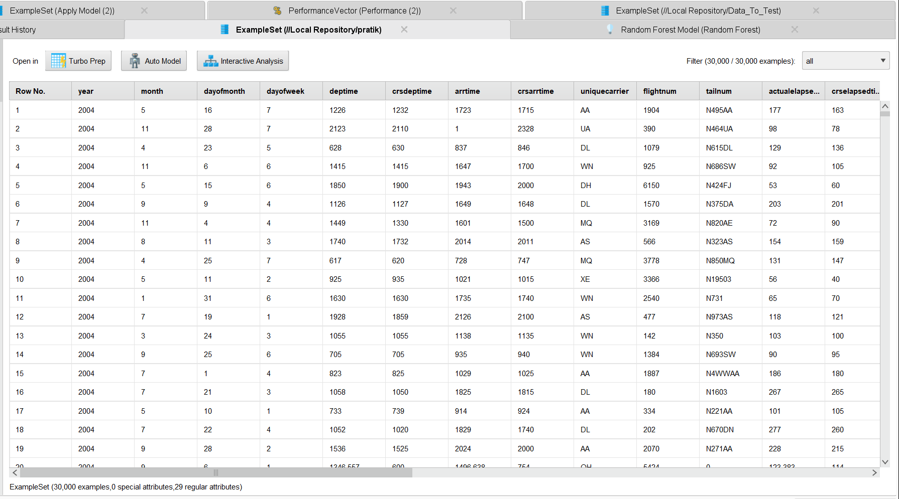
Merged file

Slide 16
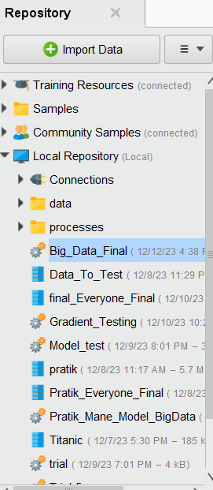
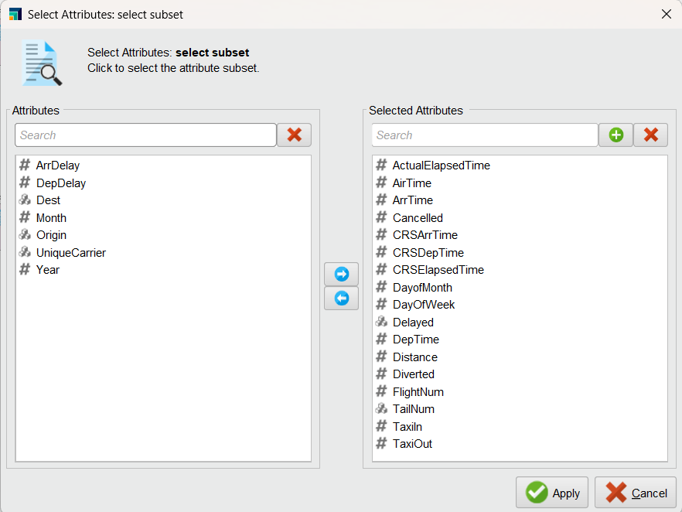
Imported data and attribute selection

Slide 17
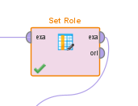
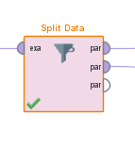
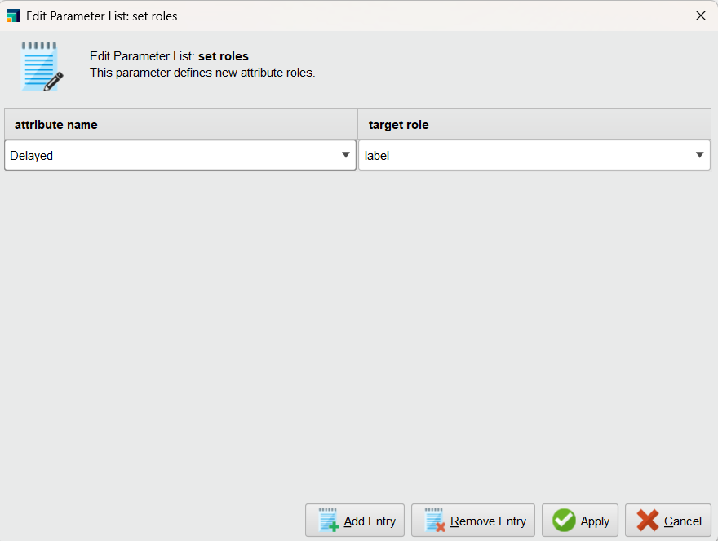
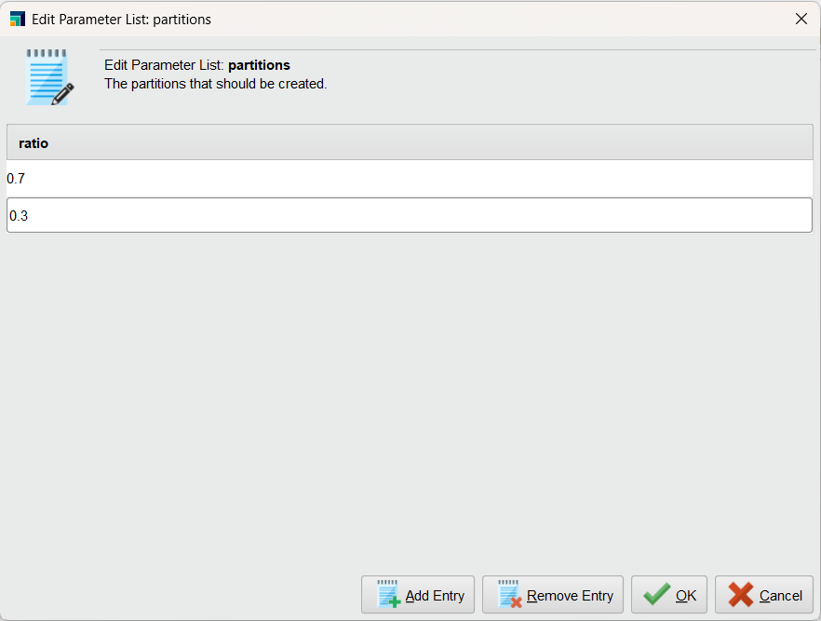
Set Role and Split data

Slide 18
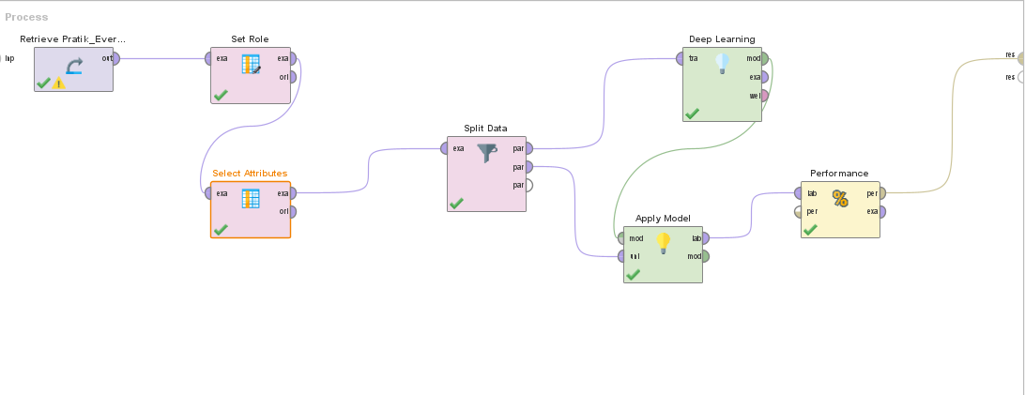
Process

Slide 19
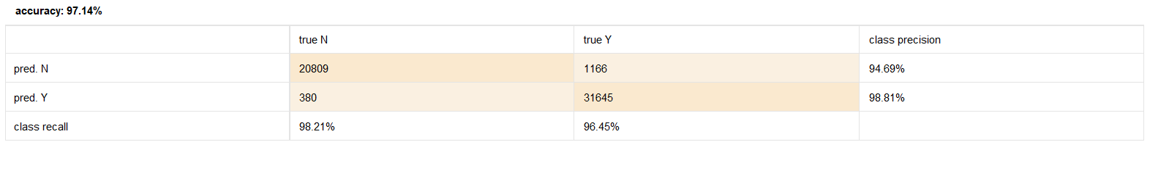
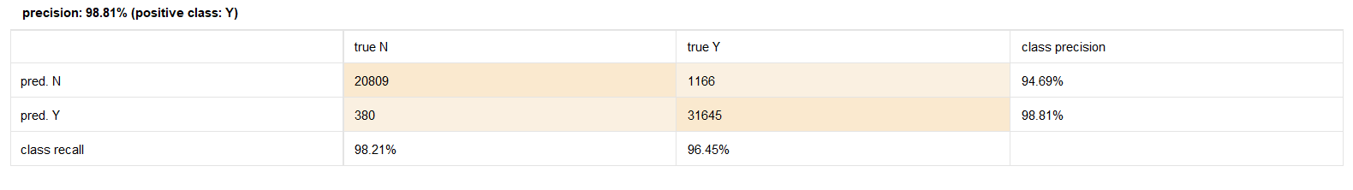
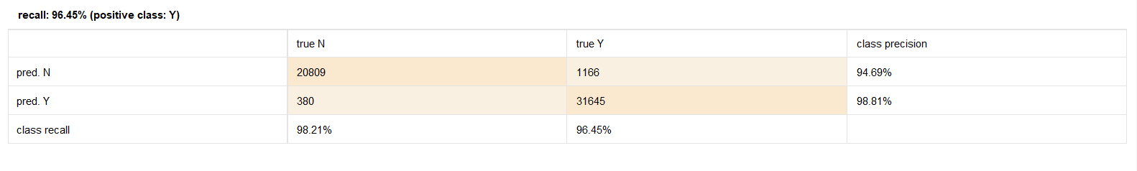
Accuracy and precision and recall

Slide 20
WE HAVE SELECTED DEEP LEARNING AS OUR FINAL MODEL FOR TESTING

Slide 21
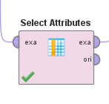
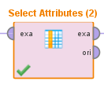
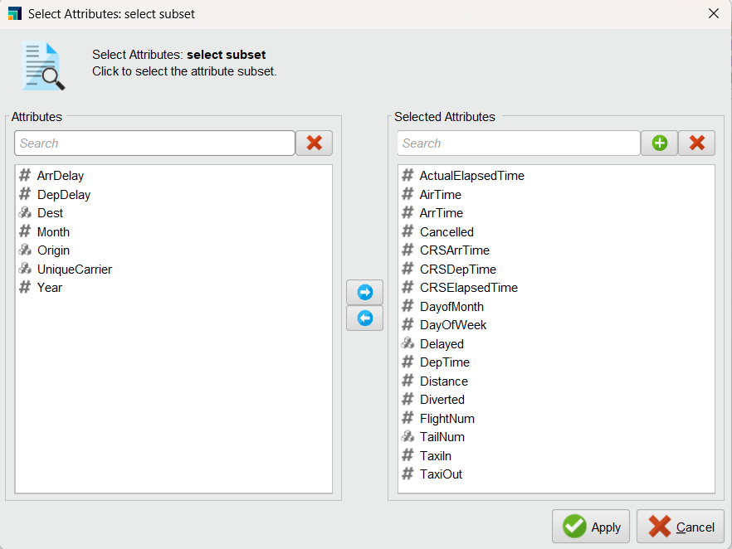
Labeled and unlabeled attribute selections

Slide 22
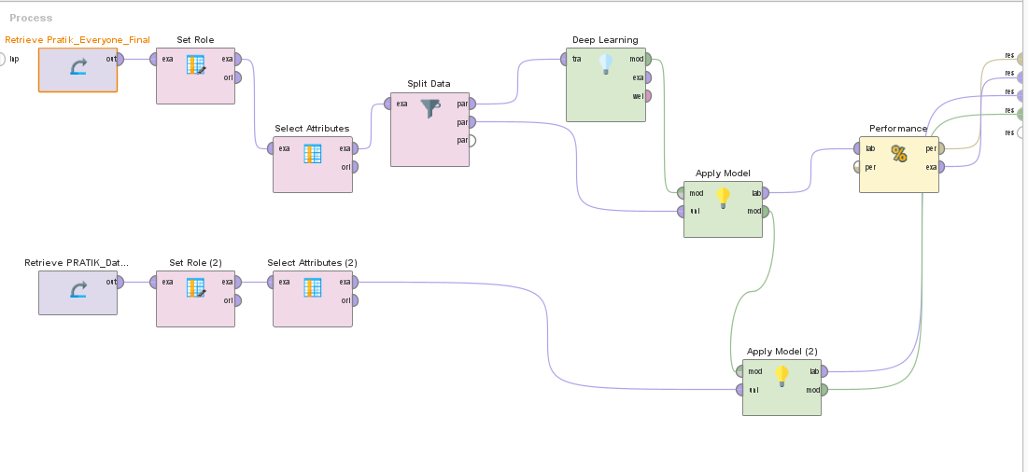
Process for final model

Slide 23
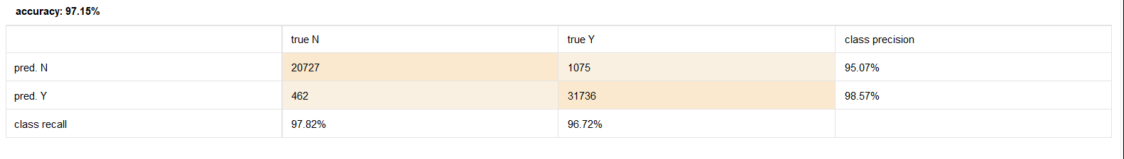
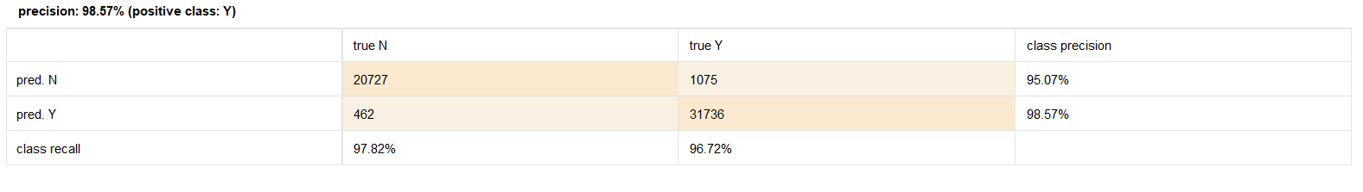
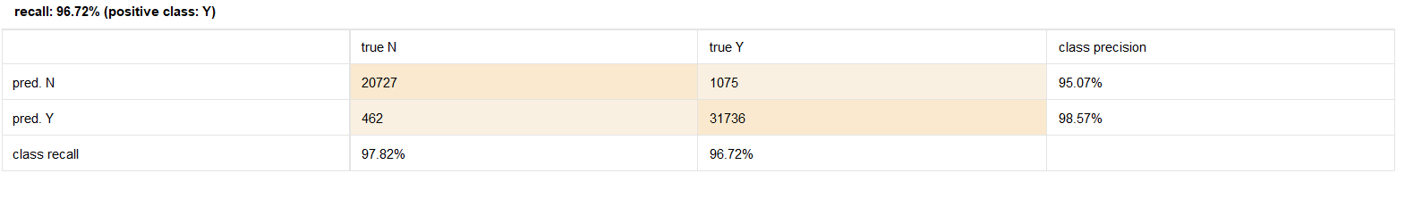
Accuracy and Precision and recall for final testing model

Slide 24
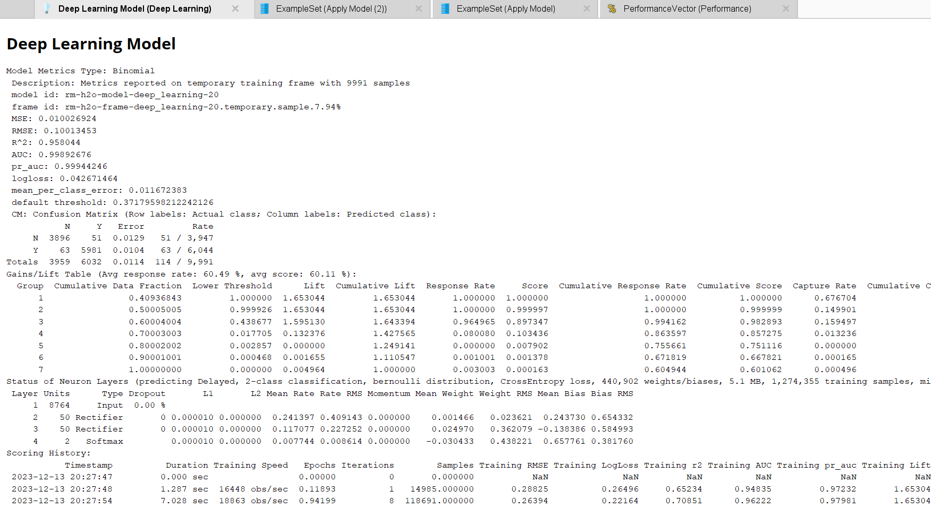

Slide 25
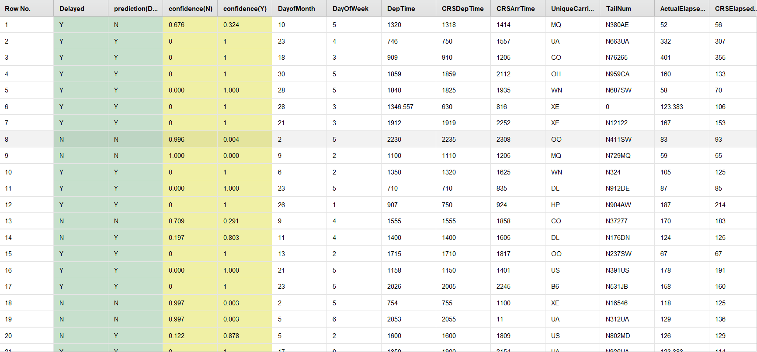
PREDICTION FOR MERGED DATA

Slide 26
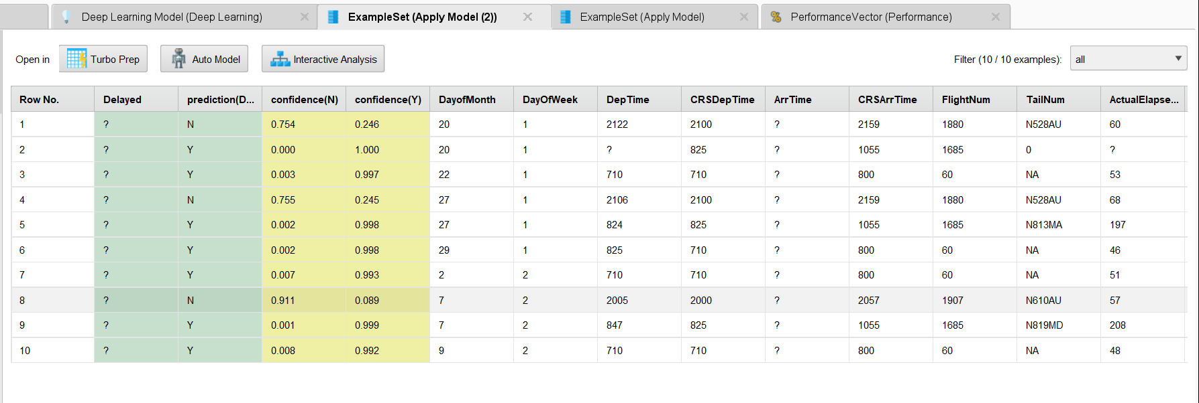
Prediction for 10 dataset

